Slide 1
Parallel Lines
Angles on parallel lines

Slide 2
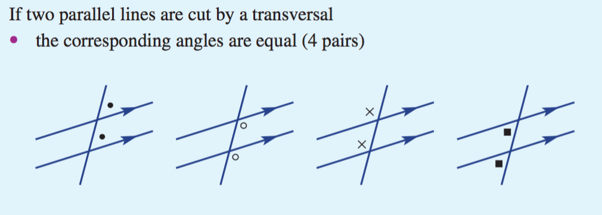
Topic: Parallel Lines
EQ: How can find missing angles in parallel lines
Parallel lines are two lines that do not cross.
The two lines are always equidistance from each other.
When the lines are intersected by a transversal line, the angle formed by this line is the same on both parallel lines.
Example:

Slide 3
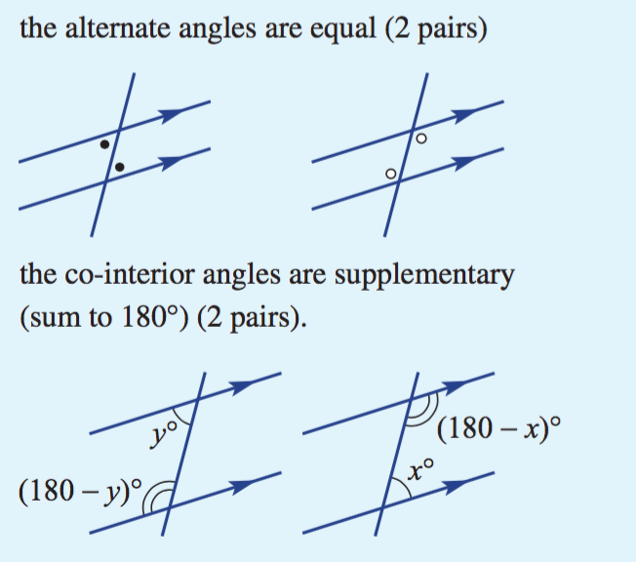
Topic: Parallel Lines
EQ: How can find missing angles in parallel lines
There are 4 relationships we deal with in parallel lines –
Corresponding : same position
Vertically Opposite: Two angles opposite each other
Co-interior: Two angles that at supplementary (add to 180º)
Alternate: Two angles in the same position around a point.

Slide 4
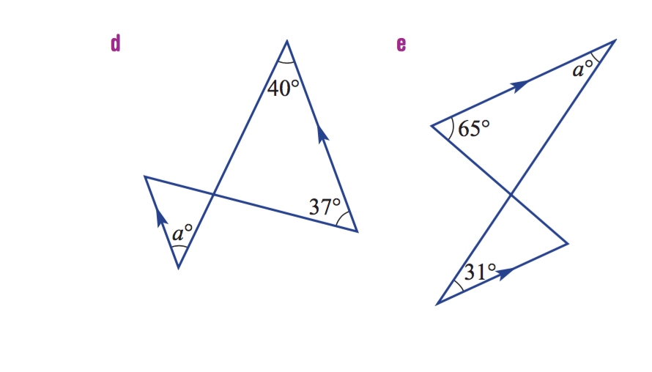


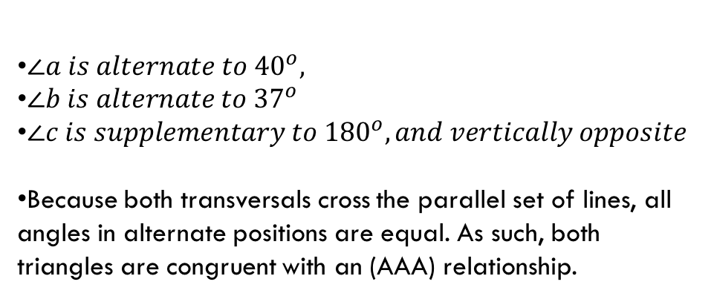
Topic: Parallel Lines
EQ: How can find missing angles in parallel lines
Parallel lines can also be used in congruency statements as proof of angle sizes; e.g.
$∠a is alternate to {40}^{o},$
$∠b is alternate to {37}^{o}$
$∠c is supplementary to {180}^{o}, and vertically opposite$
Because both transversals cross the parallel set of lines, all angles in alternate positions are equal. As such, both triangles are congruent with an (AAA) relationship.
$$b^{o}$$
$$c^{o}$$

Slide 5
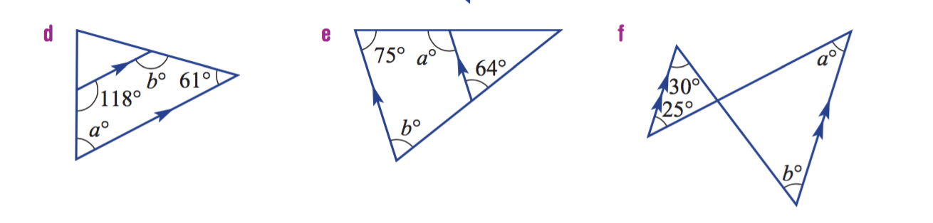
Topic: Parallel Lines
EQ: How can find missing angles in parallel lines
Practise:
A
D
A
C
A
D
E
C
C
D
E
B
B
B
E

